Slide 1

SECURITY AWARENESS IN

Slide 2
THE IMPORTANCE OF CYBER SECURITY
It allows its users to work securely without most internal or external threats.
It protects your and our personal data.
It allows us to import and export data securely.

Slide 3
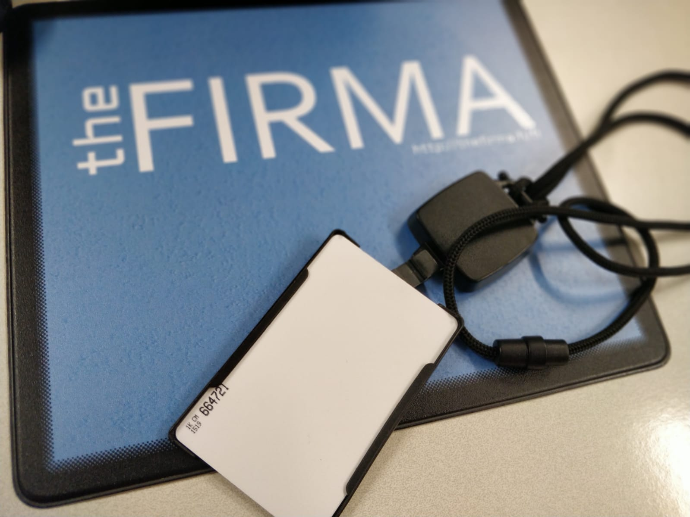
ACCESSING THE OFFICE
To get access to theFIRMA order a keycard from Turkuamk messi, when you receive your keycard ask a theFIRMA’S CEO or VP to activate it for the doors.
In case you don’t have a badge, knock on the main door, there’s is always someone who can open the door for you during working hours.
In case an unknown person enters theFIRMA; and they seem suspicious, please do not hesitate to ask what they are doing or report them .

Slide 4
USAGE OF PERSONAL DEVICE / theFIRMA’S DESKTOP
In case you decide to use your own device within theFIRMA’s network, make sure your device does not have any viruses by scanning it with a software.
We suggest using Malwarebytes which can be found in this link : https://www.malwarebytes.com
theFIRMA always provides its students/interns with a desktop ready to be used upon their arrival. All work related to theFIRMA should preferably be done on these desktops.
Always lock your device by using ( + ‘L’ or Ctrl + Alt + Delete and then selecting Lock) when leaving your desk.
Make sure all important documents/items are locked/put in a safe place.
When leaving work make sure you have logged out of theFIRMA pc you worked with.

Slide 5
UNAUTHORIZED ACCESS
You are not allowed to grant random persons access to a computer owned by theFIRMA while you are logged in. You should also avoid doing this with personal devices.
You are not allowed to give access to shared drives or similar to any third party, unless there are contractual grounds for doing so.
You are not allowed to set up or grant remote access to theFIRMA’s systems and premise in any form. However if you really need remote access talk to the sysadmins about it.

Slide 6
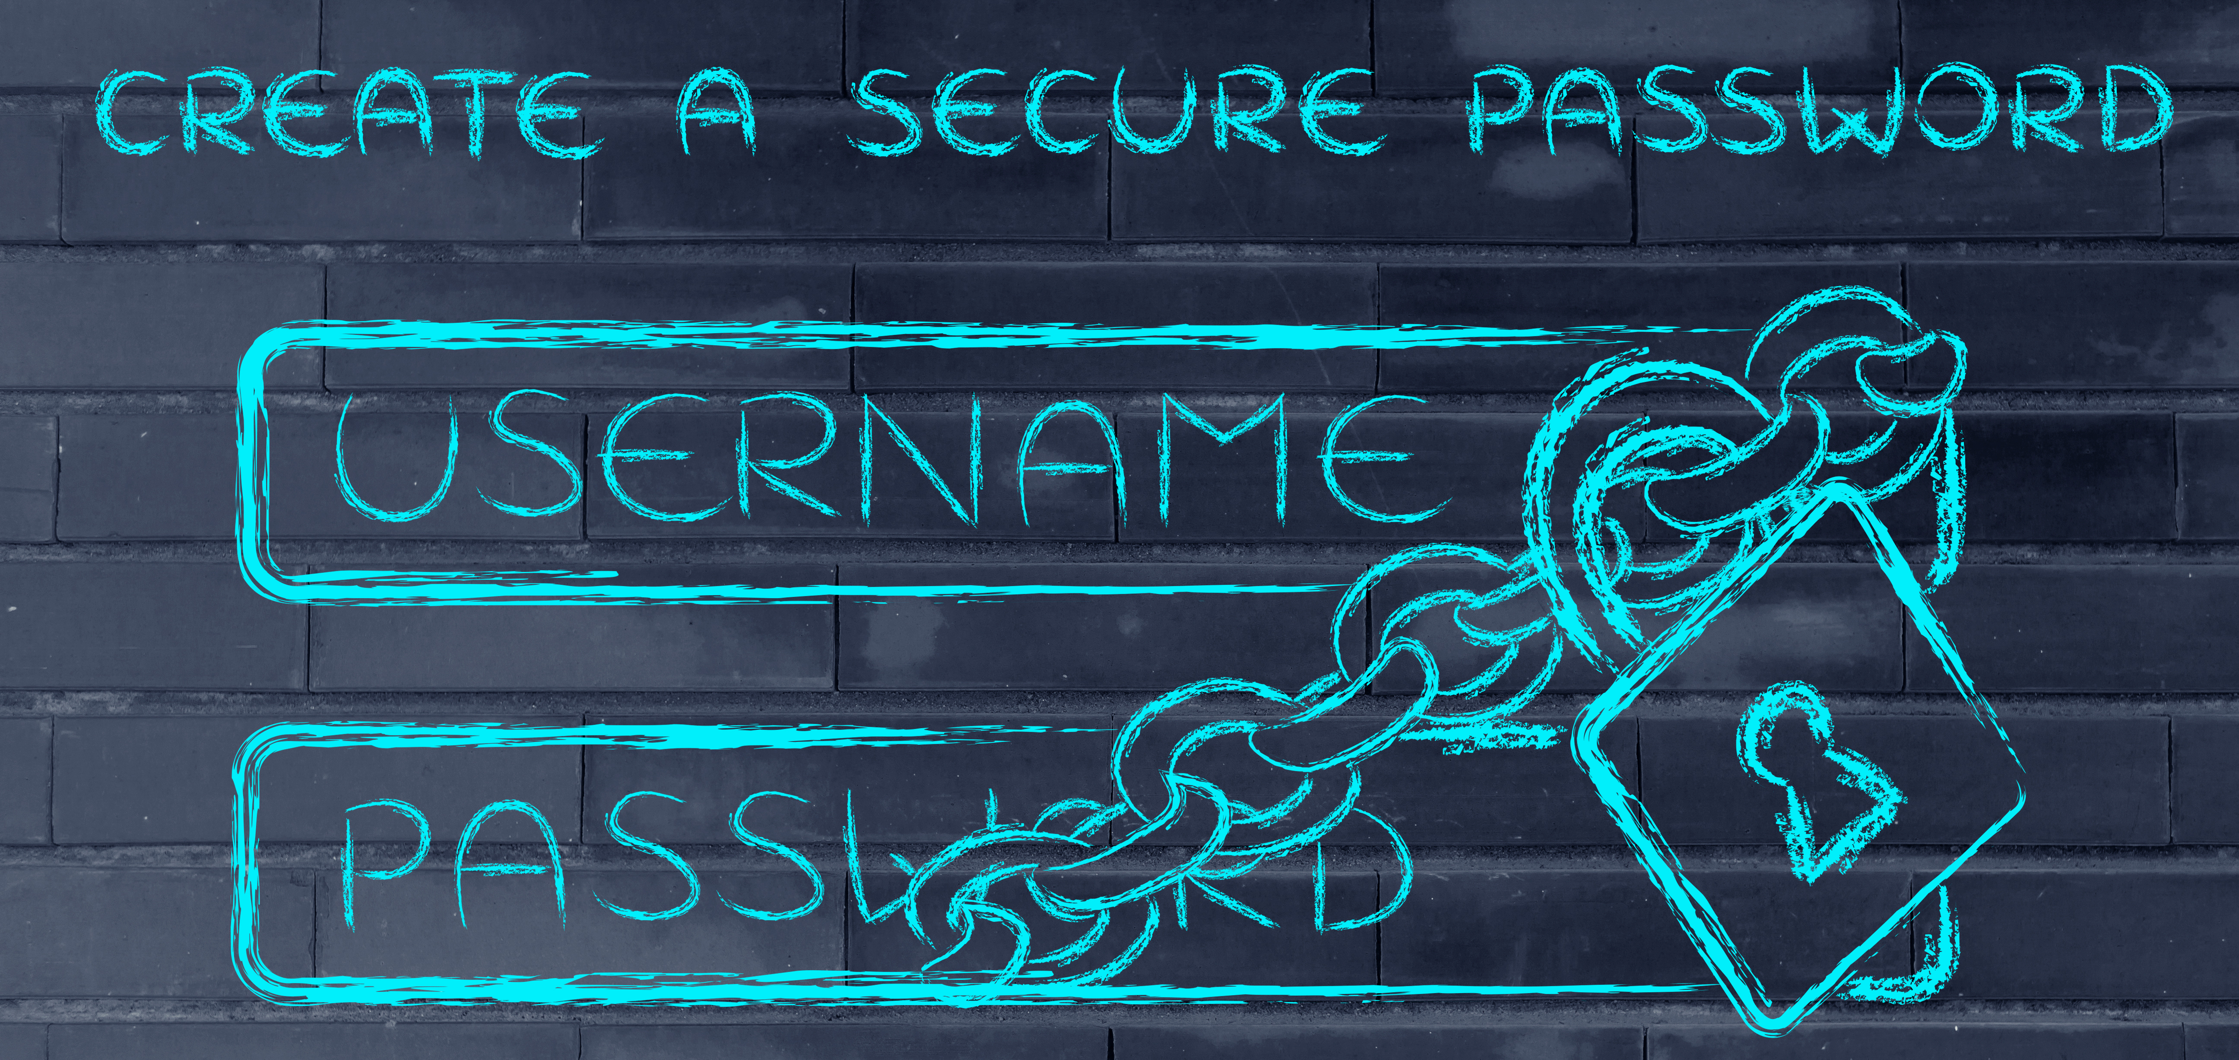
When setting up your password make sure to follow these:
Minimum length of x characters. The longer the password the better.
Mixture of letters (both upper and lower case), numbers and symbols.
You can use words and substitutions as long as the password is long. A bot will take millions of years to guess a password like laskiaispullasesonki compared to a short #nt@A)Of.
Consider using two-factor authentication or a password manager.
Keep your passwords in a password manager APP or any other safe place that no one has access to.

Slide 7

Avoid opening any unsolicited or strange e-mails. If you are unsure about an email ask an employee of theFIRMA about it.
Don’t open any attachments, don’t click any links and don’t download anything they send you if you seriously don’t know who is the sender.
Never share your personal info / account information.
There are no situations where a theFIRMA sysadmin would require your password or account name.

Slide 8
MEDIA FILES
Share project data/files trough a shared drive if possible or by e-mail after informing said person you will send them the files related to the project.
Do not insert any hardware given to you by an unknown/suspicious individual into your device.
If you find a USB-stick or a hard drive lying around please deliver it to the sysadmins at theFIRMA.

Slide 9
DATA
By signing a contract with theFIRMA/TUAS you have vowed to comply with the European General Data Protection Regulation (GDPR).
As a general rule, only collect data that is strictly necessary for your work (i.e. needed for a specific task) and DELETE it as soon as you don’t need it anymore.
Try to anonymize data whenever possible, e.g. mention a person in a document by their held position and not their name.

Slide 10

FEEDBACK
Our cyber security measures are not meant to get in your way while working, but please understand that sometimes comfort and easy usability can open the way to security issues and must therefore be regulated.
If you have any complaints or suggestions about the security measures don’t hesitate to contact the system administrator about them.

Slide 11
THE GAME
Our cyber security game makes you put what you have learned in those slides to the test.
If you feel unsure about any of the topics, please feel free to come back to this presentation to refresh your knowledge. The slides will be available on theFIRMA’s Optima page.
Keep an eye on security during your work and stay safe!

